Slide 1
Probabilistic Agents IV

Slide 2
The Variable Elimination Algorithm
$$=\left(\begin{aligned}\operatorname{Pr}\left[HS=t\right] \\ \operatorname{Pr}\left[HS=f\right]\end{aligned}\right)$$
$$=\left(\begin{aligned}0.65 \\ 0.35\end{aligned}\right)$$
$$f_{1}\left(HS\right)$$
$$=\left(\begin{aligned}\operatorname{Pr}\left[FS=t\right] \\ \operatorname{Pr}\left[FS=f\right]\end{aligned}\right)$$
$$=\left(\begin{aligned}0.4 \\ 0.6\end{aligned}\right)$$
$$f_{2}\left(FS\right)$$
$$=\left(\begin{aligned}\operatorname{Pr}\left[WM=t|CRS=t\right] \\ \operatorname{Pr}\left[WM=t|CRS=f\right]\end{aligned}\right)$$
$$=\left(\begin{aligned}0.82 \\ 0.01\end{aligned}\right)$$
$$f_{4}\left(CRS\right)$$
Remove repeated calculations
Idea: memoize!
Cache values so we don’t have to redo them again!
Evaluate equations in right-to-left order
Bottom up from tree’s pov
Factors: matrices
Indexed by values of argument R.V.s
$f_{4}$ doesn’t need $WM$ as an argument b/c $WM$ is fixed by the query!
$$f_{3}\left(CRS,HS,FS\right)$$
$$f_{4}\left(CRS\right)$$
$$\operatorname{Pr}\left[HS \right|WM=t]=α\operatorname{Pr}\left[hs\right]\sum_{fs}{\operatorname{Pr}\left[fs\right]\sum_{crs}{\operatorname{Pr}\left[crs | hs,fs\right]\operatorname{Pr}\left[wm | crs\right]}}$$
$$f_{1}\left(HS\right)$$
$$\left(\begin{matrix}Pr⁡[crs|hs,fs] & Pr⁡[¬crs|hs,fs] \\ Pr⁡[crs|¬hs,fs] & Pr⁡[¬crs|¬hs,fs]\end{matrix}\right)$$
$$f_{2}\left(FS\right)$$
$$=$$
$$\left(\begin{matrix}Pr⁡[crs|hs,¬fs] & Pr⁡[¬crs|hs,¬fs] \\ Pr⁡[crs|¬hs,¬fs] & Pr⁡[¬crs|¬hs,¬fs]\end{matrix}\right)$$
$$f_{3}\left(CRS,HS,FS\right)$$

Slide 3
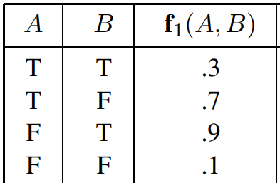
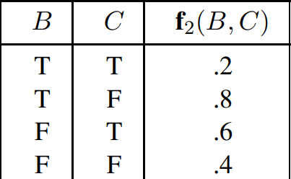
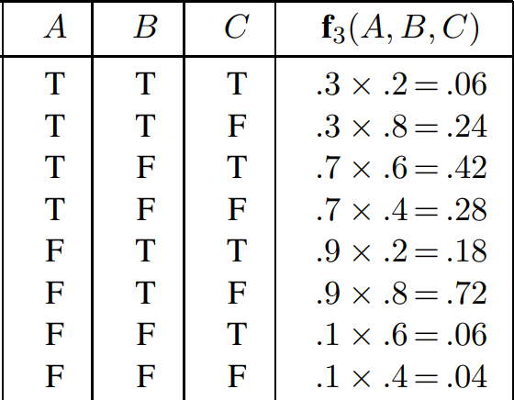
The Variable Elimination Algorithm
$$×$$
$$=$$
Given these factors
$×$ = pointwise product operator
Takes two factors (i.e. matrices) as arguments
Produces a new factor as output (i.e. a matrix)
R.V.s of output factor are union of argument factors’ R.V.s
Elements of output factor are product of corresponding elements in argument factors
$$\operatorname{Pr}\left[HS \right|WM=t]=α\operatorname{Pr}\left[hs\right]\sum_{fs}{\operatorname{Pr}\left[fs\right]\sum_{crs}{\operatorname{Pr}\left[crs | hs,fs\right]\operatorname{Pr}\left[wm | crs\right]}}$$
$$\operatorname{Pr}\left[HS \right|WM=t]=αf_{1}\left(HS\right)×\sum_{fs}{f_{2}\left(FS\right)× \sum_{crs}{f_{3}\left(CRS,HS,FS\right)×f_{4}\left(CRS\right) }}$$
$$f_{6}(HS,FS)$$
$$=\left(f_{3}\left(crs,HS,FS\right)×f_{4}\left(crs\right)\right)+\left(f_{3}\left(¬crs,HS,FS\right)×f_{4}\left(¬crs\right)\right)$$

Slide 4
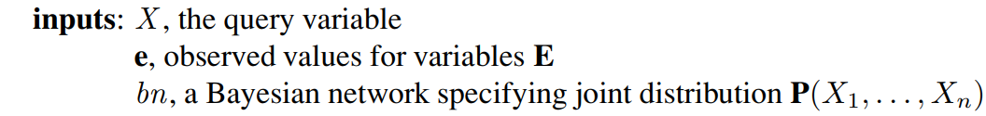

The Variable Elimination Algorithm
Whenever we sum out factors
Any factor that doesn’t depend on the R.V. being summed out is a constant!
Move it outside of the sum!
Note that $×$ is lazy: it only happens when we need to sum out a R.V.
$$f\left(B,C\right)= \sum_{a}{f_{i}\left(B\right)×f_{j}\left(A,B\right)×f_{k}\left(A,C\right)×f_{m}(C)}$$
$$=f_{i}\left(B\right)×f_{m}\left(C\right)×\sum_{a}{f_{j}\left(A,B\right)×f_{k}(A,C)}$$

Slide 5
Variable Elimination and ORDER
Different orderings of variables produce different intermediary factors
Want to choose the ordering that does less work!
Intractable to know optimal ordering
Can order using heuristics that are “good enough”
Common choice: greedy heuristic
Eliminate whichever variable minimizes the size of the output factor
In general:
Remove any leaf node that is not a query R.V. or an evidence R.V.
Every R.V. that is not an ancestor of a query R.V. or evidence R.V. is irrelevant
HenriScratch
FrankScratch
CouchRippingSound
$$=αPr⁡[hs]\sum_{hs}{Pr⁡[hs]\sum_{crs}{Pr⁡[crs|hs,fs]\sum_{fm}{Pr⁡[fm|crs]}}}$$
WifeMessage
$$\operatorname{Pr}\left[WM \right|HS=t]$$
FriendMessage
$$=αPr⁡[hs]\sum_{hs}{Pr⁡[hs]\sum_{crs}{Pr⁡[crs|hs,fs] }}$$

Slide 6
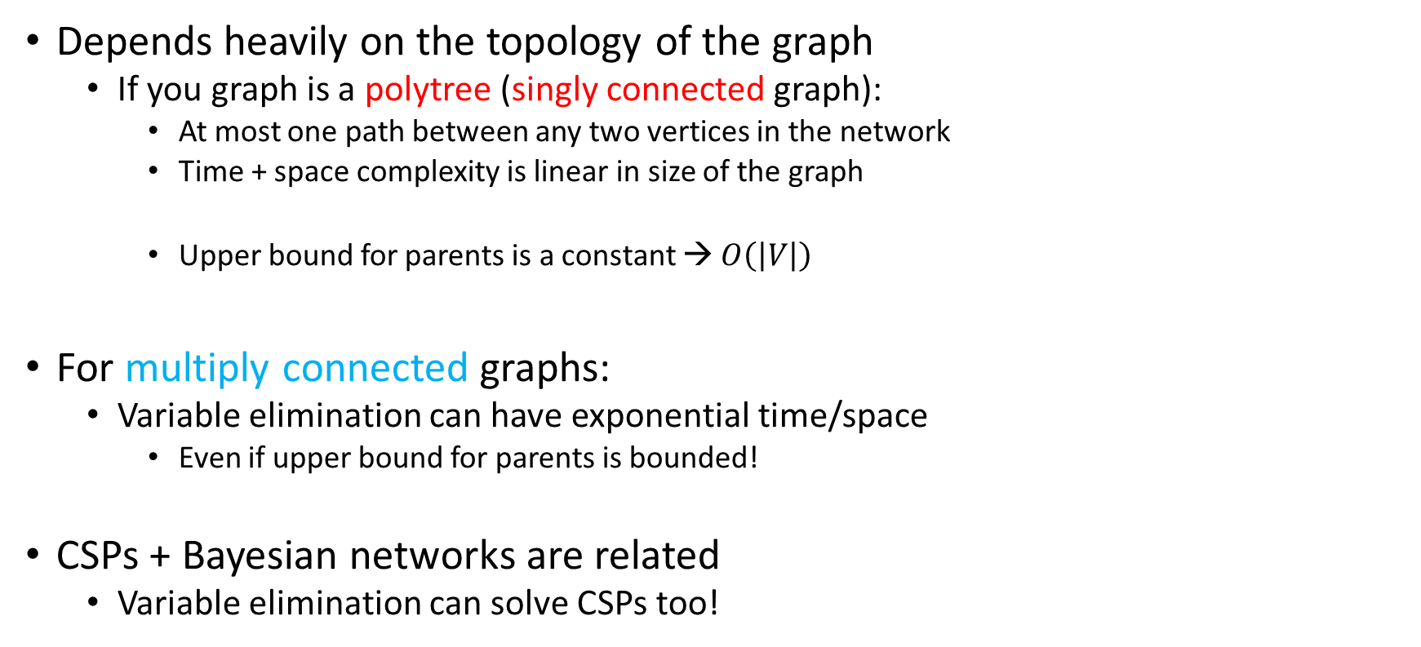
Runtime for Exact Inference
HenriScratch
FrankScratch
CouchRippingSound
Depends heavily on the topology of the graph
If you graph is a polytree (singly connected graph):
At most one path between any two vertices in the network
Time + space complexity is linear in size of the graph
Upper bound for parents is a constant → $O\left(\left|V\right|\right)$
For multiply connected graphs:
Variable elimination can have exponential time/space
Even if upper bound for parents is bounded!
CSPs + Bayesian networks are related
Variable elimination can solve CSPs too!
WifeMessage
FriendMessage
Singly-connected graph
cloudy
sprinkler
rain
wetgrass
Multiply-connected graph

Slide 7
Skipping Topics
Chapter 14.4.4 -> end of chapter
Converting multiply-connected graphs → singly-connected graphs
Approximate inference
Direct sampling
Rejection sampling
Likelihood weighting
MCMC
Gibbs sampling
Learning distributions from data

Slide 8
Our Example Data
Outlook | Temperature | Humidity | Windy? | Play Outside?
Sunny | Hot | High | False | No
Sunny | Hot | High | True | No
Overcast | Hot | High | False | Yes
Rainy | Mild | High | False | Yes
Rainy | Cool | Normal | False | Yes
Rainy | Cool | Normal | True | No
Overcast | Cool | Normal | True | Yes
Sunny | Mild | High | False | No
Sunny | Cool | Normal | False | Yes
Rainy | Mild | Normal | False | Yes
Sunny | Mild | Normal | True | Yes
Overcast | Mild | High | True | Yes
Overcast | Hot | Normal | False | Yes
Rainy | Mild | High | True | No

Slide 9
First Convert into Numeric Representation
Outlook | Temperature | Humidity | Windy? | Play Outside?
0 | 2 | 1 | 0 | 0
0 | 2 | 1 | 1 | 0
1 | 2 | 1 | 0 | 1
2 | 1 | 1 | 0 | 1
2 | 0 | 0 | 0 | 1
2 | 0 | 0 | 1 | 0
1 | 0 | 0 | 1 | 1
0 | 1 | 1 | 0 | 0
0 | 0 | 0 | 0 | 1
2 | 1 | 0 | 0 | 1
0 | 1 | 0 | 1 | 1
1 | 1 | 1 | 1 | 1
1 | 2 | 0 | 0 | 1
2 | 1 | 1 | 1 | 0

Slide 10
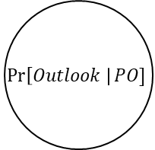
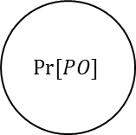
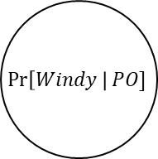
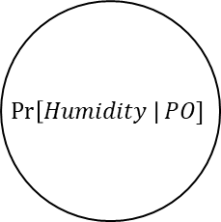
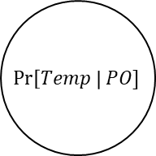
Visually
$$\operatorname{Pr}\left[Outlook \right|PO]$$
$$\operatorname{Pr}\left[Temp \right|PO]$$
Outlook | Temperature | Humidity | Windy? | Play Outside?
0 | 2 | 1 | 0 | 0
0 | 2 | 1 | 1 | 0
1 | 2 | 1 | 0 | 1
2 | 1 | 1 | 0 | 1
2 | 0 | 0 | 0 | 1
2 | 0 | 0 | 1 | 0
1 | 0 | 0 | 1 | 1
$$Pr⁡[PO]$$
0 | 1 | 1 | 0 | 0
0 | 0 | 0 | 0 | 1
2 | 1 | 0 | 0 | 1
0 | 1 | 0 | 1 | 1
1 | 1 | 1 | 1 | 1
1 | 2 | 0 | 0 | 1
$$\operatorname{Pr}\left[Humidity \right|PO]$$
2 | 1 | 1 | 1 | 0
An instance of a Bayesian network
$$\operatorname{Pr}\left[Windy \right|PO]$$

Slide 11


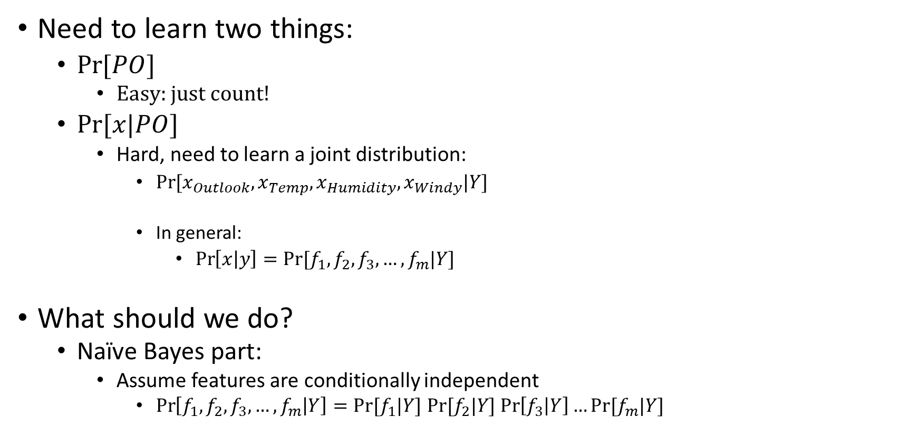


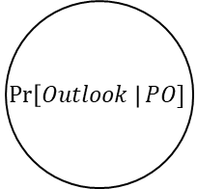
The Hard Part
Outlook | Temperature | Humidity | Windy? | Play Outside?
0 | 2 | 1 | 0 | 0
0 | 2 | 1 | 1 | 0
1 | 2 | 1 | 0 | 1
2 | 1 | 1 | 0 | 1
2 | 0 | 0 | 0 | 1
2 | 0 | 0 | 1 | 0
1 | 0 | 0 | 1 | 1
0 | 1 | 1 | 0 | 0
0 | 0 | 0 | 0 | 1
2 | 1 | 0 | 0 | 1
0 | 1 | 0 | 1 | 1
1 | 1 | 1 | 1 | 1
1 | 2 | 0 | 0 | 1
$$\operatorname{Pr}\left[Outlook \right|PO]$$
Need to learn two things:
$\operatorname{Pr}{[PO]}$
Easy: just count!
$Pr⁡[x|PO]$
Hard, need to learn a joint distribution:
$Pr⁡[x_{Outlook},x_{Temp},x_{Humidity},x_{Windy}|Y]$
In general:
$\operatorname{Pr}\left[x | y\right]=Pr⁡[f_{1},f_{2},f_{3},…, f_{m}|Y]$
What should we do?
Naïve Bayes part:
Assume features are conditionally independent
$\operatorname{Pr}\left[f_{1},f_{2},f_{3},…, f_{m} | Y\right]=Pr⁡[f_{1}|Y]$ $Pr⁡[f_{2}|Y]$ $\operatorname{Pr}\left[f_{3} | Y\right]…Pr⁡[f_{m}|Y]$
2 | 1 | 1 | 1 | 0
Play Outside? = y | Pr[PO=y]
0 | 5/14
1 | 9/14
$$\operatorname{Pr}\left[Temp \right|PO]$$
$$Pr⁡[PO]$$
$$\operatorname{Pr}\left[Humidity \right|PO]$$
$$\operatorname{Pr}\left[Windy \right|PO]$$

Slide 12
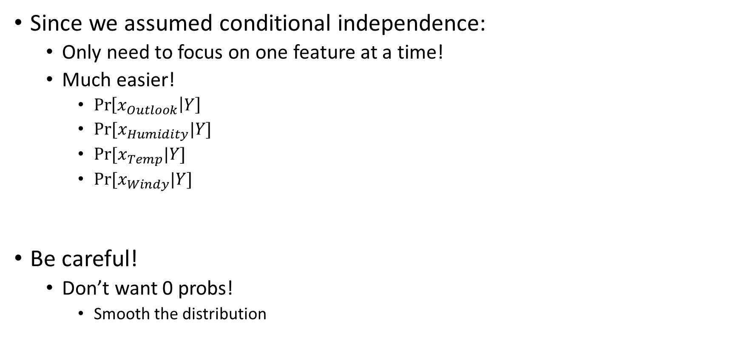
Naïve Bayes
Outlook | Temperature | Humidity | Windy? | Play Outside?
0 | 2 | 1 | 0 | 0
0 | 2 | 1 | 1 | 0
1 | 2 | 1 | 0 | 1
2 | 1 | 1 | 0 | 1
2 | 0 | 0 | 0 | 1
2 | 0 | 0 | 1 | 0
1 | 0 | 0 | 1 | 1
0 | 1 | 1 | 0 | 0
0 | 0 | 0 | 0 | 1
2 | 1 | 0 | 0 | 1
0 | 1 | 0 | 1 | 1
1 | 1 | 1 | 1 | 1
1 | 2 | 0 | 0 | 1
Since we assumed conditional independence:
Only need to focus on one feature at a time!
Much easier!
$\operatorname{Pr}\left[x_{Outlook} | Y\right]$
$Pr⁡[x_{Humidity}|Y]$
$Pr⁡[x_{Temp}|Y]$
$Pr⁡[x_{Windy}|Y]$
Be careful!
Don’t want 0 probs!
Smooth the distribution
2 | 1 | 1 | 1 | 0
Outlook | Pr[Outlook = x | Y = 0] | Pr[Outlook = x | Y = 1]
0 | 3/5 | 2/9
1 | 0/5 | 4/9
2 | 2/5 | 3/9
Humidity | Pr[Humidity = x | Y = 0] | Pr[Humidity = x | Y = 1]
0 | 2/5 | 6/9
1 | 3/5 | 3/9

Slide 13
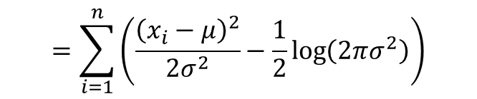
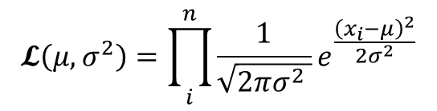
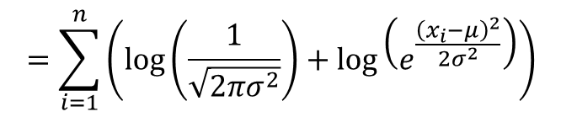
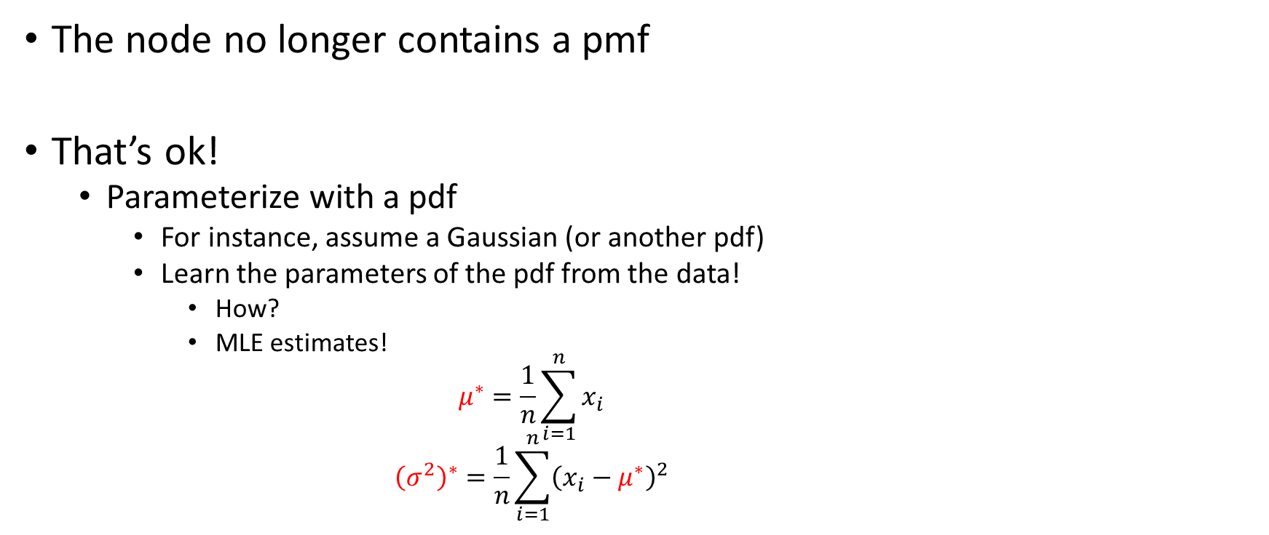
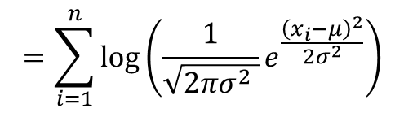
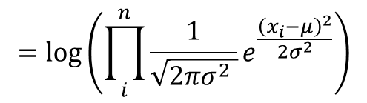

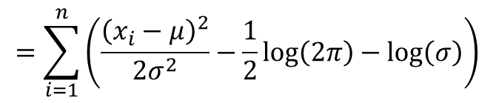
Continuous Features
$$𝓛\left(μ,σ^{2}\right)=\prod_{i}^{n}{\frac{1}{\sqrt{2πσ^{2} }}e^{\frac{{\left(x_{i}−μ\right)}^{2}}{2σ^{2}}}}$$
$$𝓛𝓛\left(μ,σ^{2}\right)=\log\left(𝓛\left(μ,σ^{2}\right)\right)$$
$$=\log\left(\prod_{i}^{n}{\frac{1}{\sqrt{2πσ^{2} }}e^{\frac{{\left(x_{i}−μ\right)}^{2}}{{2σ}^{2}}}}\right)$$
The node no longer contains a pmf
That’s ok!
Parameterize with a pdf
For instance, assume a Gaussian (or another pdf)
Learn the parameters of the pdf from the data!
How?
MLE estimates!
$$μ^{∗}=\frac{1}{n}\sum_{i=1}^{n}{x_{i}}$$
$${\left(σ^{2}\right)}^{∗}=\frac{1}{n}\sum_{i=1}^{n}{{\left(x_{i}−μ^{∗}\right)}^{2}}$$
$$=\sum_{i=1}^{n}{\log\left(\frac{1}{\sqrt{2πσ^{2} }}e^{\frac{{\left(x_{i}−μ\right)}^{2}}{{2σ}^{2}}}\right)}$$
$$=\sum_{i=1}^{n}{\left(\log\left(\frac{1}{\sqrt{2πσ^{2}}}\right)+\log\left(e^{\frac{{\left(x_{i}−μ\right)}^{2}}{{2σ}^{2}}}\right)\right)}$$
$$=\sum_{i=1}^{n}{\left(\frac{{\left(x_{i}−μ\right)}^{2}}{{2σ}^{2}}−\frac{1}{2}\log\left(2πσ^{2}\right)\right)}$$
$$=\sum_{i=1}^{n}{\left(\frac{{\left(x_{i}−μ\right)}^{2}}{{2σ}^{2}}−\frac{1}{2}\log\left(2π\right)−\log\left(σ\right)\right)}$$

Slide 14
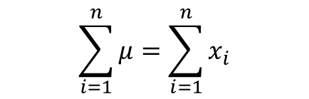
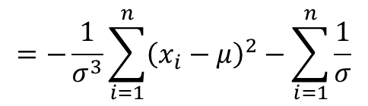
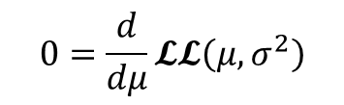
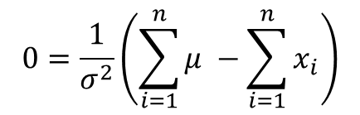
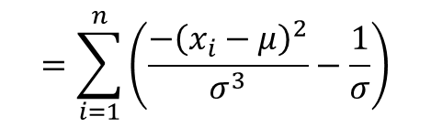

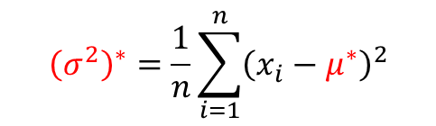

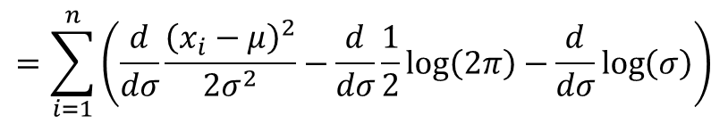
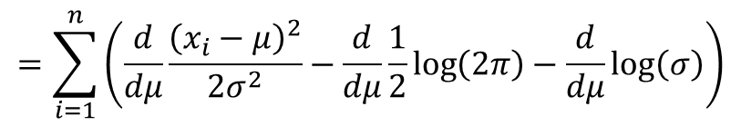
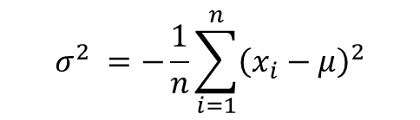
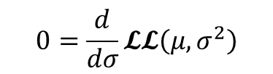
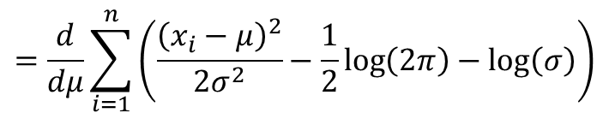
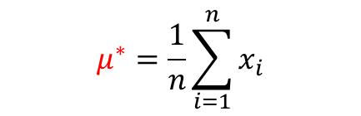
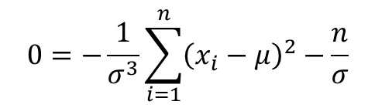
MLE for Gaussian (1d)
$μ^{∗}, {\left(σ^{2}\right)}^{∗}$?
Have to differentiate twice
$$0=\frac{d}{dμ}𝓛𝓛\left(μ,σ^{2}\right)$$
$$0=\frac{d}{dσ}𝓛𝓛\left(μ,σ^{2}\right)$$
$$=\frac{d}{dμ}\sum_{i=1}^{n}{\left(\frac{{\left(x_{i}−μ\right)}^{2}}{2σ^{2}}−\frac{1}{2}\log\left(2π\right)−\log\left(σ\right)\right)}$$
$$=\sum_{i=1}^{n}{\left(\frac{d}{dσ}\frac{{\left(x_{i}−μ\right)}^{2}}{{2σ}^{2}}−\frac{d}{dσ}\frac{1}{2}\log\left(2π\right)−\frac{d}{dσ}\log\left(σ\right)\right)}$$
$$=\sum_{i=1}^{n}{\left(\frac{d}{dμ}\frac{{\left(x_{i}−μ\right)}^{2}}{{2σ}^{2}}−\frac{d}{dμ}\frac{1}{2}\log\left(2π\right)−\frac{d}{dμ}\log\left(σ\right)\right)}$$
$$=\sum_{i=1}^{n}{\left(\frac{−{\left(x_{i}−μ\right)}^{2}}{σ^{3}}−\frac{1}{σ}\right)}$$
$$σ^{2} =−\frac{1}{n}\sum_{i=1}^{n}{{\left(x_{i}−μ\right)}^{2}}$$
$$=\sum_{i=1}^{n}{\frac{2\left(x_{i}−μ\right)}{{2σ}^{2}}(−1)}$$
$$\sum_{i=1}^{n}{μ}=\sum_{i=1}^{n}{x_{i}}$$
$$=−\frac{1}{σ^{3}}\sum_{i=1}^{n}{{\left(x_{i}−μ\right)}^{2}}−\sum_{i=1}^{n}{\frac{1}{σ}}$$
$${\left(σ^{2}\right)}^{∗}=\frac{1}{n}\sum_{i=1}^{n}{{\left(x_{i}−μ^{∗}\right)}^{2}}$$
$$μ^{∗}=\frac{1}{n}\sum_{i=1}^{n}{x_{i}}$$
$$0=−\frac{1}{σ^{3}}\sum_{i=1}^{n}{{\left(x_{i}−μ\right)}^{2}}−\frac{n}{σ}$$
$$0=\frac{1}{σ^{2}}\left(\sum_{i=1}^{n}{μ} −\sum_{i=1}^{n}{x_{i}}\right)$$

